Slide 1
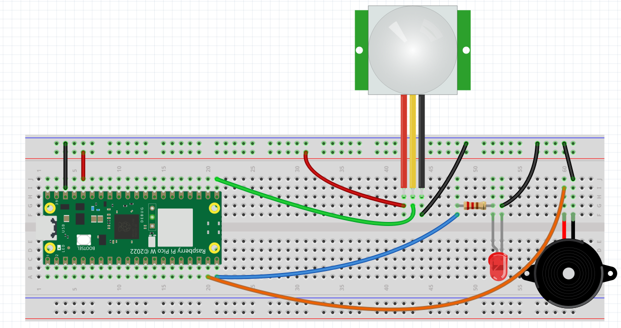
TESTING THE PIR
PIR DATA PIN – GPIO16
RED LED PIN – GPIO15
BUZZER PIN – GPIO 14
As usual, do not follow the drawing
But check the pins physically
Refer to next slide/page
Testing the Passive Infra-red Motion Sensor

Slide 2
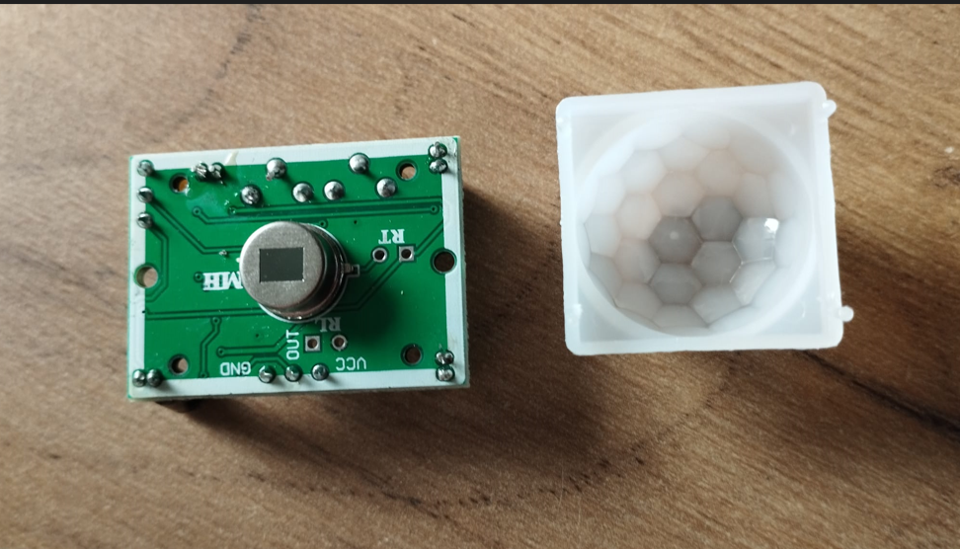
Gently remove the plastic cap from the PIR
The pins are marked on the device itself.
Follow these pin markings and not the drawing

Slide 3
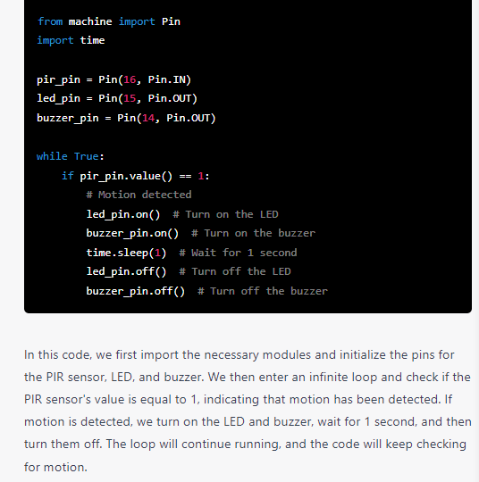
Program to Test the PIR
When motion is detected
The LED and Buzzer
Will be activated.

Slide 4
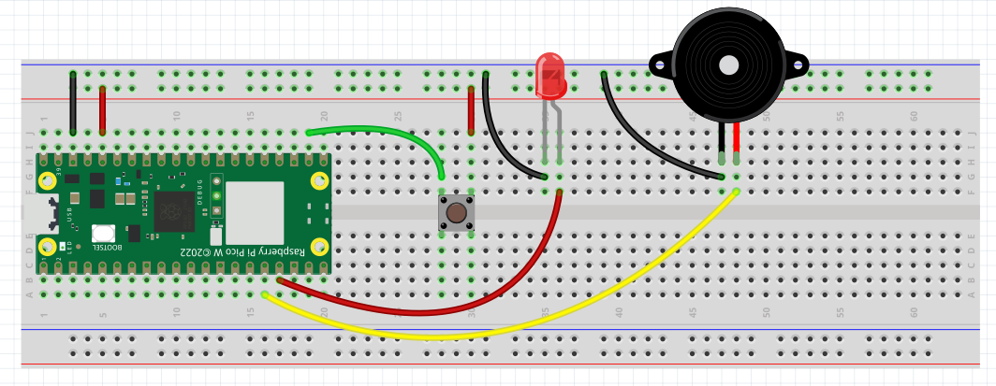
Testing the Button
The LED’s limiting resistor
Is missing. Please add
Button is on GPIO17 - PULL-DOWN (meaning pin is connected to 3V3 instead of Ground
Red LED is on GPIO13
Buzzer is on GPIO12

Slide 5
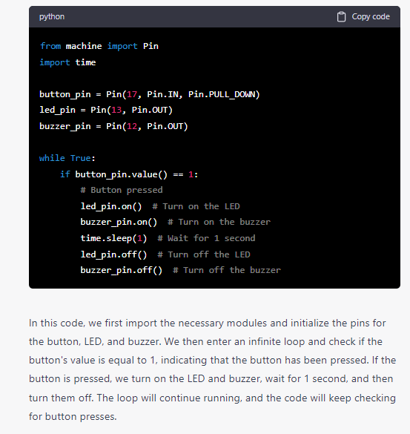
Program to Test the Button
When button is pressed
The LED and Buzzer
Will be activated.

Slide 6
Carefully Examine the code for both the PIR and Button
With the knowledge gain, construct a Burglar Alarm
Burglar Alarm is active when armed (use button and led)
Burglar Alarm is deactivated when disarmed with password
Refer to Raspberry Pi 4 course notes (Lesson 4) for Burglar Alarm
Drawing is attached.
https://github.com/ssgoh/Intro_To_Raspberry_Pi/blob/main/Pi%20Python%20Course%20Material%20-%20Rev%202.pdf

